Slide 1
Team 15: |Bruh-Ket>
SC Quantum: Quantathon V1 – Oct. 11th-12th
Ashton McEntarffer, Jonathan Maenche, Julien Caillaud

Slide 2

Challenge
Implement a quantum layer as part of a computer vision machine learning framework

Slide 3
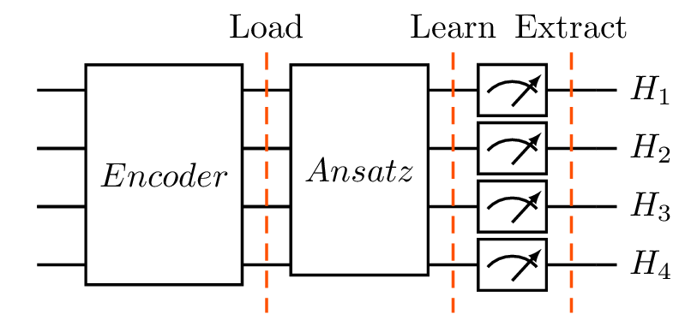
Assignment

Slide 4
Objectives
Most Accurate Model
Consistent Analysis Process
Thorough Documentation

Slide 5
Phases
Planning
Ansatz Analysis
Accuracy Analysis and Customization
Presentation

Slide 6
Workflow
Phase 1
Planning, Preparation, and Problem Research
Phase 3
Accuracy Analysis and Customization
10:30 AM
5:45 PM
8:30 PM
3:00 AM
Phase 2
Ansatz Analysis
Phase 4
Presentation Prep and Final Model Work

Slide 7
Ansatz Analysis

Slide 8
Control Variables
The following variables were chosen because they are the default values that each ansatz have, and we wanted to see their base performance.
Qubits: 4
CNOT Gates: 5
Entangled Layers: 2
Epochs: 6

Slide 9
Expected Performance
01
QCNNAnsatz
CNN is specialized for image classification
02
Shallow circuit minimizes noise
BrickworkLayoutAnsatz
03
Has elements of orthogonal and CNN analysis, middle performance
QAOAAnsatz
04
Not well suited for spatial data
ButterflyOrthogonalAnsatz,CrossOrthogonalAnsatz

Slide 10
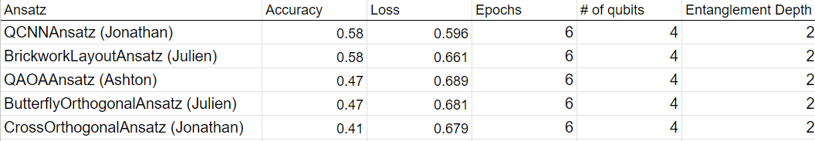
Initial Results

Slide 11
Accuracy Analysis and Customization

Slide 12
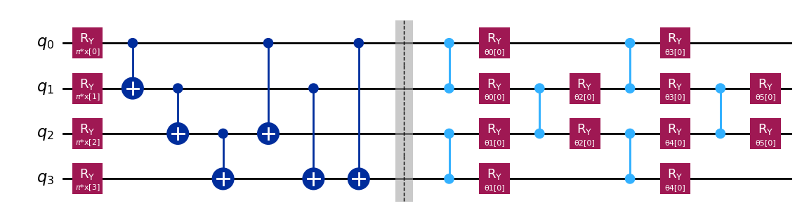
BrickworkLayer Ansatz: Quantum Variables
Number of qubits | Entanglement | Quantum Features
4 | 4 | X₀, X₁, X₂, and X₃
Notes:
Julien

Slide 13
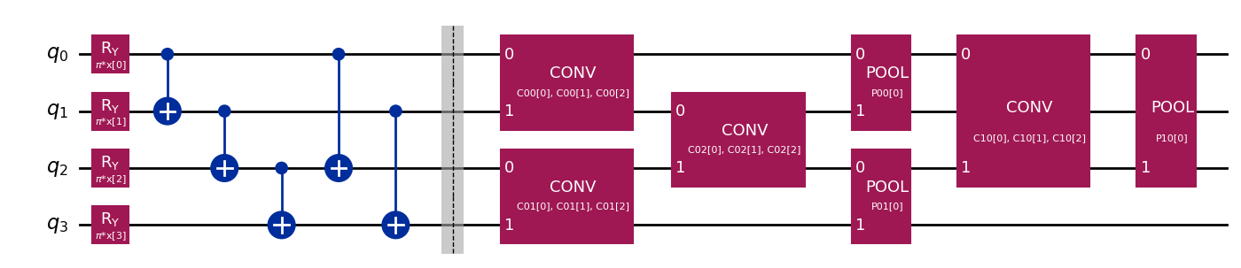
QCNN-Ansatz: Quantum Variables
Number of qubits | Entanglement | Quantum Features
4 | 2 | X₀, Y₀, Z₀, and X₂

Slide 14
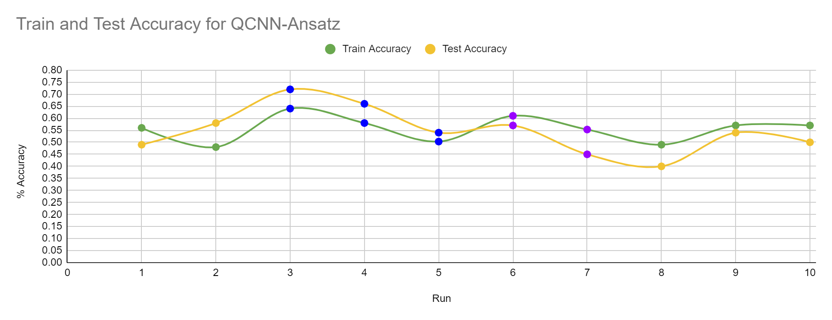
Results

Slide 15
Hyperparameters
Training size | 300
Learning rate | 0.1
Batch size | 50
Weight decay | 0.001

Slide 16
So what does this tell us?
Best models for quantum binary image classification…
QCNN
Brickwork
Best parameters…
Pauli list (describes which quantum features to pass back to the classical workflow)
Qubit amount
Entanglement complexity

Slide 17
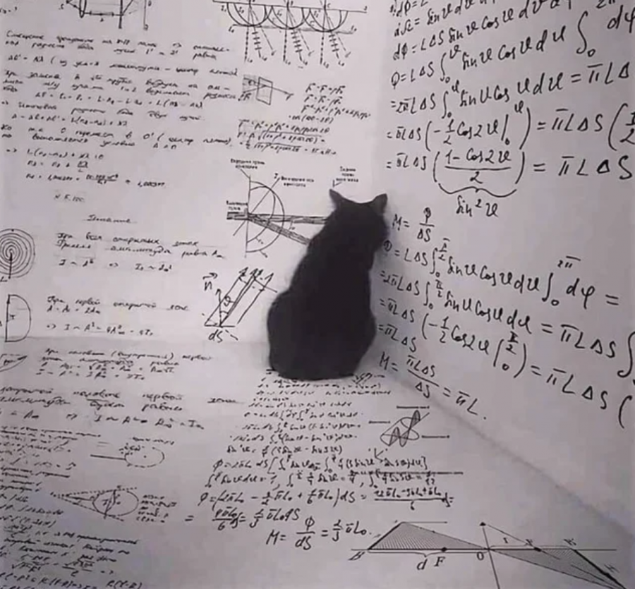
Future Work
Investigating different types of encoders
Custom Ansatz and various optimization techniques

Slide 18
Thank You!

